Slide 1

TWITTER COMMENT
SENTIMENTAL ANALYSIS
SUBMITTED BY: PRAJITH
DATA ANALYTICS TECHOLAS TECHNOLOGIES KOCHI
SUBMITTED TO:
SHAYANA FACULTY,
DATA ANALYTICS TECHOLAS TECHNOLOGIES KOCHI
Notes:
<a href="https://www.freepik.com/free-photos-vectors/business">Business vector created by pikisuperstar - www.freepik.com</a>

Slide 2
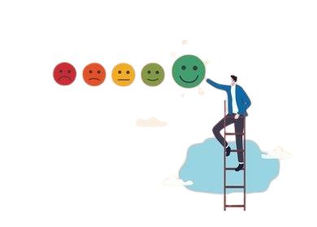
Objective
The goal of this project is to analyze Twitter comments and classify them into six emotions: joy, sad, anger, fear, surprise, and love.
Use machine learning to identify emotions in tweets accurately.
Analyze large datasets to find emotional trends and patterns.
Help organizations understand public emotions and make better decisions.
Notes:
<a href="https://www.freepik.com/free-photos-vectors/business">Business vector created by pikisuperstar - www.freepik.com</a>

Slide 3
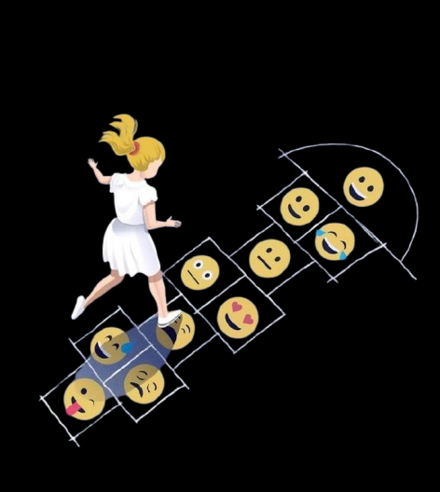
Design Of Website
The project leverages Python and Streamlit to develop an interactive and efficient user interface, ensuring seamless functionality and user experience. Jupyter Notebook serves as the primary development environment, facilitating efficient coding, testing, and prototyping
Notes:
<a href="https://www.freepik.com/free-photos-vectors/business">Business vector created by pikisuperstar - www.freepik.com</a>

Slide 4
Process On Dataset
PREDICTED CLASS LABEL
PREDICT THE TEST DATA
MODEL TRAINING AND TESTING
FITTING THE TRAINED DATA IN MODEL
MODEL SELECTION
DATA STANDARDIZATI ON AND SPLIT TO TRAIN AND TEST
DATA PRE-PROCESING
DATA COLLECTION
Notes:
<a href="https://www.freepik.com/free-photos-vectors/business">Business vector created by pikisuperstar - www.freepik.com</a>

Slide 5
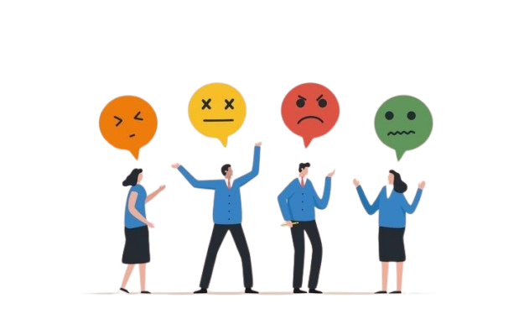
Dataset
Input: Comment to examine,Label sentimental analysis
Output: Predict 6 different emotion
Joy
Sad
Love
Anger
Fear
Surprise
Notes:
<a href="https://www.freepik.com/free-photos-vectors/business">Business vector created by pikisuperstar - www.freepik.com</a>

Slide 6
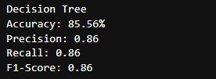
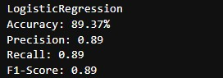
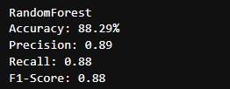
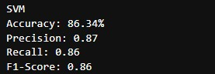
Result Obtained
Notes:
<a href="https://www.freepik.com/free-photos-vectors/business">Business vector created by pikisuperstar - www.freepik.com</a>

Slide 7
Comparison Table
MODELS | ACCURACY(%) | PRECISION | RECALL | F1 SCORE
Random Forest | 88.29% | 0.89 | 0.88 | 0.88
Decision Tree | 85.56% | 0.86 | 0.86 | 0.86
Logistic Regression | 89.37% | 0.89 | 0.89 | 0.89
SVM | 86.34% | 0.87 | 0.86 | 0.86
Notes:
<a href="https://www.freepik.com/free-photos-vectors/business">Business vector created by pikisuperstar - www.freepik.com</a>

Slide 8
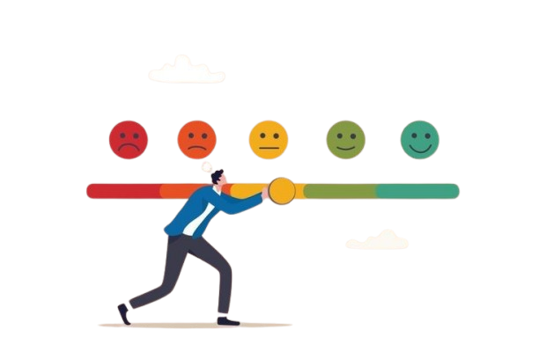
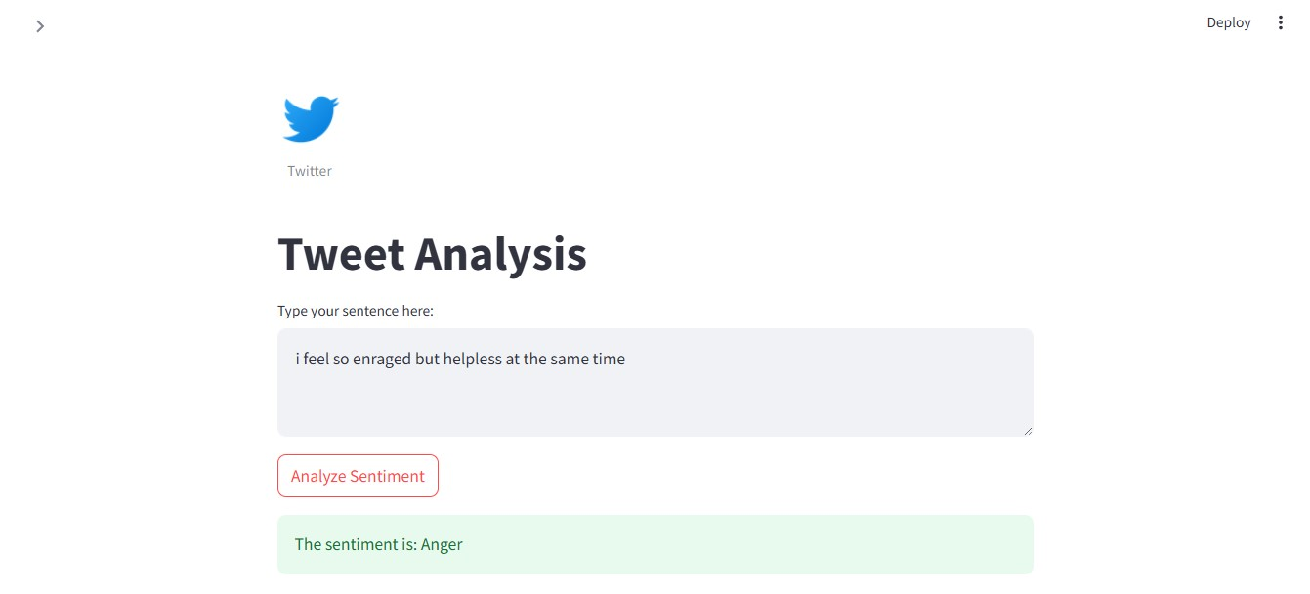
User Interface
Notes:
<a href="https://www.freepik.com/free-photos-vectors/business">Business vector created by pikisuperstar - www.freepik.com</a>

Slide 9

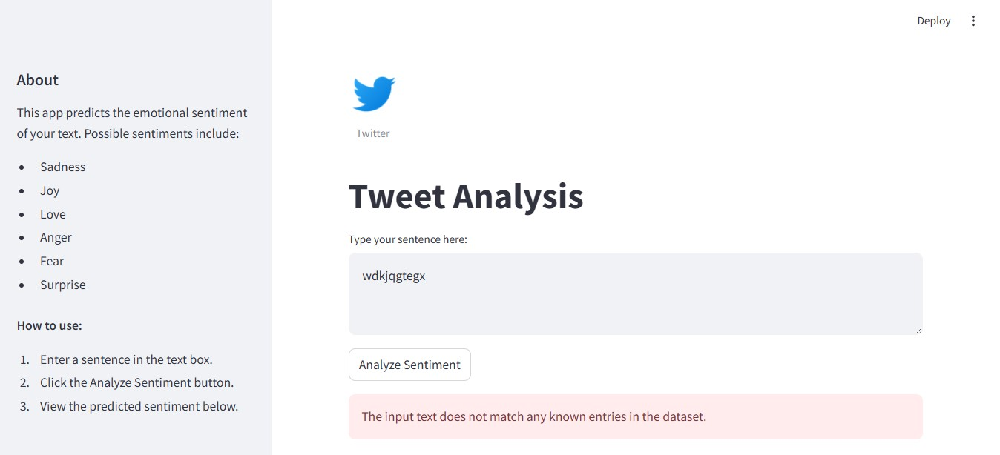
User Interface
Notes:
<a href="https://www.freepik.com/free-photos-vectors/business">Business vector created by pikisuperstar - www.freepik.com</a>

Slide 10
Application
Track Customer Feelings: Understand emotions like happiness or anger in customer feedback about your product or service.
Improve Marketing: See if tweets about your campaign show surprise or happiness, helping you adjust strategies.
Handle Complaints Faster: Spot angry or sad tweets to prioritize and resolve customer issues quickly.
Analyze Public Opinion: Measure emotions like fear or disgust during events, news, or debates to understand public reactions.

Slide 11

Reference : Kaggle

Slide 12
THANK
YOU
Notes:
<a href="https://www.freepik.com/free-photos-vectors/business">Business vector created by pikisuperstar - www.freepik.com</a>

